Slide 1
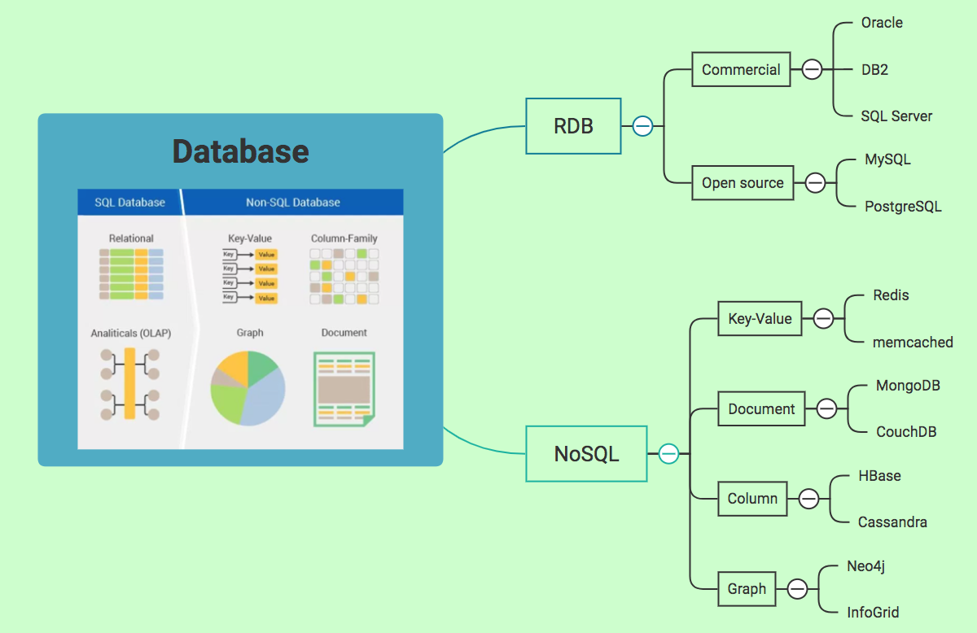
Notes:
（1）键值存储数据库（key-value）
键值数据库就类似传统语言中使用的哈希表。可以通过key来添加、查询或者删除数据库，因为使用key主键访问，所以会获得很高的性能及扩展性。
键值数据库主要使用一个哈希表，这个表中有一个特定的键和一个指针指向特定的数据。Key/value模型对于IT系统来说的优势在于简单、易部署、高并发。
（2）面向文档（Document-Oriented）数据库
面向文档数据库会将数据以文档形式存储。每个文档都是自包含的数据单元，是一系列数据项的集合。每个数据项都有一个名词与对应值，值既可以是简单的数据类型，如字符串、数字和日期等；也可以是复杂的类型，如有序列表和关联对象。数据存储的最小单位是文档，同一个表中存储的文档属性可以是不同的，数据可以使用XML、JSON或JSONB等多种形式存储。
（3）列存储（Column-oriented）数据库
列存储数据库将数据存储在列族中，一个列族存储经常被一起查询的相关数据，比如人类，我们经常会查询某个人的姓名和年龄，而不是薪资。这种情况下姓名和年龄会被放到一个列族中，薪资会被放到另一个列族中。
这种数据库通常用来应对分布式存储海量数据。
（4）图形数据库
图形数据库允许我们将数据以图的方式存储。实体会被作为顶点，而实体之间的关系则会被作为边。比如我们有三个实体，Steve Jobs、Apple和Next，则会有两个“Founded by”的边将Apple和Next连接到Steve Jobs。
图形数据库是将社交关系等数据描述为点（Vertex）和边（Edge）及他们的属性（Property），每一张图（Graph）都可以看做是一个结构化数据。

Slide 2
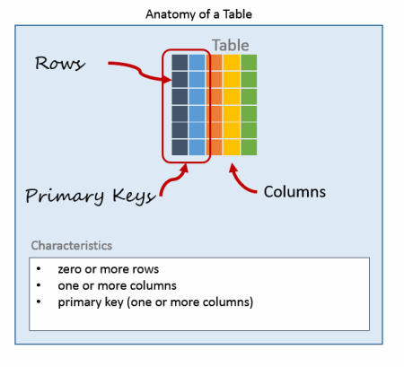
Tables
Indexes
Views
Stored Procedures
Triggers
id | name | location
1 | Mike | Shenzhen
2 | Jason | Shanghai
id | user | tweet
1 | 1 | 1
2 | 1 | 2
3 | 2 | 1
id | content | word_count
1 | Morning… | 100
2 | Night… | 200
Relational databases stores data in tables.
Each table is defined with multiple columns.
Each table has a primary key that uniquely identifies rows.
Tables can have foreign keys that relate the table to other tables

Slide 3
A database view is a searchable object in a database that is defined by a query. Though a view doesn’t store data, some refer to a views as “virtual tables,” you can query a view like you can a table. A view can combine data from two or more table, using joins, and also just contain a subset of information. This makes them convenient to abstract, or hide, complicated queries.
Notes:
1)Table
Tables are used to store data within the database. They are its main component and without them, the database would serve little purpose. Tables are uniquely named within a database. Many operations, such as queries use these names. Typically a table is named to represent the type of data stored within.
2)INdex
Indexes are used to make data retrieval faster. Rather than having to scan an entire table for data, an index allows the database to, essentially, directly retrieve the data being asked of it. An index consists of keys, which in most cases directly relate to columns in a table.
3)View
Relationships between SQL database tables can become quite complicated as data is stored in separate tables. Views help combat this issue by allowing the database administrator to create “canned” or pre-built queries that developers, report writer, and users can use in their own database queries. In this way, the view hides some of the database complexity. This makes it easier to read queries
4) Stored Procedures
There are many situations where queries alone are insufficient to solve a problem. In these cases, developers rely on programming languages to process logic, to loop through records, and perform conditional comparisons as required. These programs can be stored in the SQL database as stored procedures.
5) Triggers
Triggers are special instructions that are executed when important events, such as inserting or updating records in a table happen. The most common triggers are Insert, Update, and Delete triggers. Two items define a trigger on a table: a stored procedure and an event, such as inserting a record that invokes its execution.

Slide 4
数据表类型（存储引擎）
数据库引擎用于存储、处理和保护数据的核心服务，利用数据库引擎可控制访问权限并快速处理事务，利用数据库引擎创建用于联机事务处理或联机分析处理数据的关系数据库，包括创建用于存储数据的表和用于查看、管理、保护数据安全的数据库对象（索引、视图、存储过程）。
Notes:
1）为了提高索引的速度，可以为经常进行索引的列添加索引，相当于创建目录。
2）创建索引的方式：在表设计器中点击右键，选择“索引键”→添加→在列中选择索引包含的列。
3）使用索引能提高查询效率，但是索引也是占据空间的，而且添加、更新、删除数据时的时候也需要同步更新索引，因此会降低Insert、Update、Delete的速度。只在警检索的字段上创建索引。
4）即使创建了索引，仍然有可能全表扫描，比如like、函数、类型转换等。

Slide 5
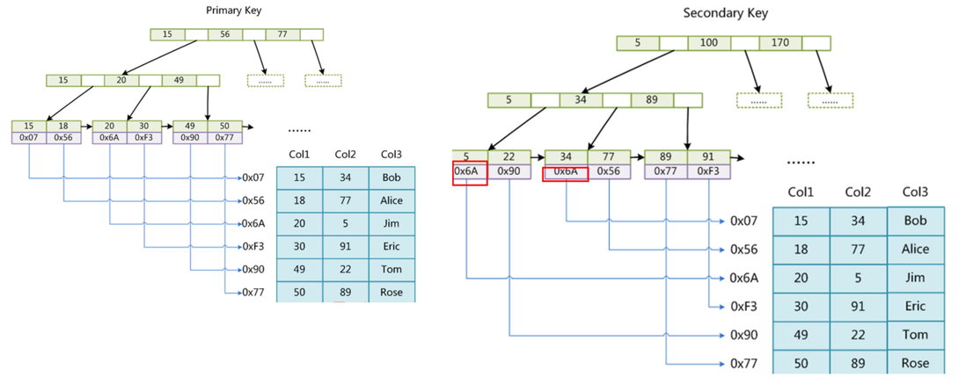
Myisam
Store engine
Innodb

Slide 6
Notes:
Database-stored procedures are sets of pre-compiled SQL statements created in the server, called and executed by database applications. It is very simple and the same result can be archived by SQL query.
Stored Procedures Advantages
Stored procedures increase the performance of an application. Once created, stored procedure is compiled and stored in the database catalog. It runs faster than an uncompiled SQL commands which are sent from application
Stored procedure reduces the traffic between application and database server because instead of sending multiple uncompiled long SQL commands statement, application has only to send the stored procedure name and get the result back.
Stored procedure is reusable and transparent to any application which wants to use it. Stored procedure exposes the database interface to all applications so developer doesn’t have to program the functions which are already supported in stored procedure in all programs.
Stored procedure is secured. Database administrator can grant the right to application which to access which stored procedures in database catalog without granting any permission on the underlying database table.
Stored Procedures Disadvantages
Stored procedure make the database server high load in both memory and processors. Instead of being focused on the storing and retrieving data, you could be asking the database server to perform a number of logical operations or a complex of business logic which is not the role of it.
Stored procedure only contains declarative SQL so it is very difficult to write a procedure with complexity of business like other languages in application layer such as Java, C#, C++…
You cannot debug stored procedure in almost RDMBSs and in MySQL also. There are some workarounds on this problem but it still not good enough to do so.
Writing and maintain stored procedure usually required specialized skill set that not all developers possess. This introduced the problem in both application development and maintain phrase.

Slide 7
Login MySQL
mysql -u root -p
create database
create database test
use database
use test
create table student( name varchar(30) not null, English tinyint unsigned not null, Math tinyint unsigned not null, Computer tinyint unsigned not null );
Create table
insert into student values("zhangsan",69,86,77);
Insert data
update student set Math=95 where name="lisi";
Update data
Select * from student where name="lisi";
Query table

Slide 8
a database can be seen as the following figure
a database is divided into multiple components that interact with each other.
Notes:
The core components:
The process manager: Many databases have a pool of processes/threads that needs to be managed. Moreover, in order to gain nanoseconds, some modern databases use their own threads instead of the Operating System threads.
The network manager: Network I/O is a big issue, especially for distributed databases. That’s why some databases have their own manager.
File system manager: Disk I/O is the first bottleneck of a database. Having a manager that will perfectly handle the Operating System file system or even replace it is important.
The memory manager: To avoid the disk I/O penalty a large quantity of ram is required. But if you handle a large amount of memory, you need an efficient memory manager. Especially when you have many queries using memory at the same time.
Security Manager: for managing the authentication and the authorizations of the users
Client manager: for managing the client connections
…
The tools:
Backup manager: for saving and restoring a database.
Recovery manager: for restarting the database in a coherent state after a crash
Monitor manager: for logging the activity of the database and providing tools to monitor a database
Administration manager: for storing metadata (like the names and the structures of the tables) and providing tools to manage databases, schemas, tablespaces, …
…
The query Manager:
Query parser: to check if a query is valid
Query rewriter: to pre-optimize a query
Query optimizer: to optimize a query
Query executor: to compile and execute a query
The data manager:
Transaction manager: to handle transactions
Cache manager: to put data in memory before using them and put data in memory before writing them on disk
Data access manager: to access data on disk

Slide 9
how a database manages an SQL query through the following processes:
Database
Client
Client Manager
Query Manager
Data Manager

Slide 10
规范化（normalization）：为了使数据不发生矛盾而将表格分开的情况
第一范式：分割非范式而得到第一范式
第二范式：按“主键的值可以确定其他列的值”这一原则来分割表格
第三范式：由主键唯一确定其他列的表格（参照方的那列称为外键(foreign key)，外键参照其他表格的主键）

Slide 11
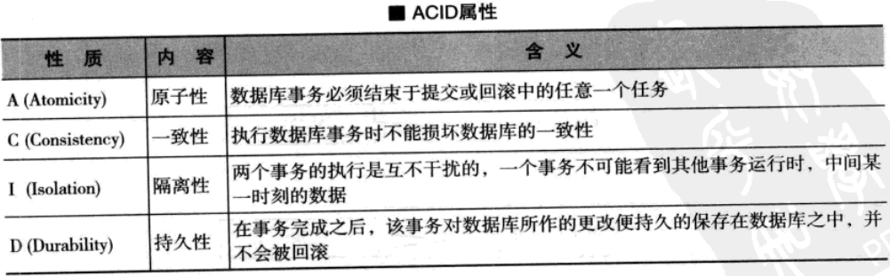
事务
事务 -> 锁（共享锁/独占锁） -> 提交（commit）/取消（rollback）
用户的一连串操作我们称之为数据库事务（transaction）
数据库事务所具有的性质称之为ACID属性

Slide 14
三 SQL基础1 [09/02/12]
3.1 语句入门
不同DBMS都认SQL语法
字符串用单引号: ’String’
SQL语句对大小写不敏感（对关键字不敏感，字符串是敏感的）
SQL主要分DDL（定义）和DML（操作）
DDL: CREATE TABLE, DROP TABLE, Alter Table等
DML: INSERT INTO TABLE, SELECT, Update, Delete等
Exp:
CREATE TABLE Test(id int not null, name nvarchar(50), age int not null)
DROP TABLE Test
INSERT INTO TABLE Test(id, name, age) VALUES(1, ‘YOU’, 20)
3.2 主键选择（两种策略：IN & GUID）
有些数据类型不能设为主键，大部分都可以设，但是一般只有两种类型作为主键：int和uniqueidetifier(GUID)
1）int+标识列
Int型主键可以设置标识为是，是系统分配自动增长的序列号。一个表只能有一个标识列。
2）GUID
Guid算法：SQLServer中产生GUID的函数newid()
3.3 数据插入/更新
1) Insert
Insert into Person (Name, Age) values(‘lily’, 220);
Insert into Person (Id, Name, Age) values(newid(), ‘lily’, 220);
2) Update
*更新一个列：UPDATE T_PERSON SET Age = 25 (/Age + 1);
*更新多个列：UPDATE T_PERSON SET Age = 25, Name = ‘lucy’;
*更新一部分：UPDATE T_PERSON SET Age = 25, Name = ‘lucy’ where (Age >= 20 and Age < 80) or NickName = ‘you’;

Slide 15
四 SQL基础2 [09/03/12]
4.1 数据删除
1) 删除表中全部数据：DELETE FROM Test
2) 删除表中部分数据：DELETE FROM PERSON WHERE Age > 20;
数据检索
SELECT */字段名 FROM TEST;
SELECT 字段名 FROM TEST WHERE Age > 20;
SELECT FName as 姓名, FAge as 年龄 FROM TEST where FSalary < 5000;
数据汇总
Select count(*) from T_Employee;
Select max(FSalary) from T_Employee;
Select min(FSalary) from T_Employee;
Select avg(FSalary) from T_Employee;
Select sum(FSalary) from T_Employee;
数据排序
select * from T_Employee order by FSalary ASC(升序ASC/降序DESC);
select * from T_Employee order by FSalary ASC, Age ASC;
order by 要放在 where 后：select * from T_Employee where Age > 20 order by FSalary ASC;
4.4 通配符过滤
1) 单字符匹配的通配符：_
Select * from T_Employee where FName like ‘_erry’;
2) 多字符匹配的通配符：%
Select * from T_Employee where FName like ‘%n%’;
Select * from T_Employee where FName like ‘DEV%’;
4.5 空值处理
1）NULL表示不知道（NULL + 1 还是NULL）
Select null + ‘123’
2）=：查询不知道返回空，还是不知道（N）
Select * from T_Employee where FName = null; (N)
3）is：where Name is NULL（Y）
Select * from T_Employee where FName is null; (Y)
Select * from T_Employee where FName is not null; (Y)
4.6 多值匹配
Select * from T_Employee where FAge = 20 or FAge = 25;
Select * from T_Employee where FAge in (20, 25);
Select * from T_Employee where FAge > 20 and FAge < 25;
Select * from T_Employee where FAge between 20 and 25;

Slide 16
五 数据分组 [09/04/12]
5.1 GROUP BY
1）GROUP BY子句必须放到WHERE之后
Select FAge, count(*) from T_Employee where FAge > 20 group by FAge;
2）没有出现在GROUP BY子句中的列是不能放到DELECT语句后的列名列表中的（聚合函数除外）
Select FAge, FName, count(*) from T_Employee group by FAge;(N)
Select FAge, max(FSalary) count(*) from T_Employee group by FAge;(Y)
Having
在where中不能使用聚合函数，必须使用having，having要放到group by 之后
Select FAge, count(*) as 人数 from T_Employee group by FAge having count(*) > 1;
2) Having是对分组后数据的过滤，能用的列和select中能用的列一样
3) Having无法代替where（where是对原始数据进行过滤）
六 限制结果集范围 [09/05/12]
限制结果集行数
Select top 3 * from T_Employee order by FSalary DESC
Select top 3 * from T_Employee
Where FNumber not in (Select top 5 * from T_Employee order by FSalary DESC)
order by FSalary DESC
七 抑制重复数据 [09/05/12]
DISTINCT
Select distinct FDepartment from T_Employee;

Slide 17
八 Union [09/05/12]
联合结果集（上下列数和数据类型要相同）
UNION
Select FName, FAge from T_TempEmployee
Union
Select FName, FAge from T_Employee
UNION ALL
Select FName from T_TempEmployee
Union all
Select FName from T_Employee
Union要进行重复扫描，效率低。
十二 Join [10/29/12]
JOIN
Select o.BillNo, c.Name, C.Age
from T_Orders as o join T_Custuomers as c on o.CustomerId = c.Id
Select o.BillNo, c.Name, C.Age
from T_Orders as o join T_Custuomers as c on o.CustomerId = c.Id
where c.Age > (select avg(Age) from T_Customers)
子查询

Slide 18
九 数据库函数 [09/06/12]
数字函数
*ABS()
*CEILING()
*FLOOR()
*ROUND()
字符串函数
*LEN()
*LOWER(), UPPER()
*LTRIM(), RTRIM()
*SUBSTRING(string, start_position, len)
日期函数
*GETDATE()
*DATEADD(datepart, number, data)：将日期增加特定时间类型（年、月。。。）的数目长度
*DATEDIFF(datepart, startdate, enddate):计算两个日期之间的差额
*DATEPART(datepart, date)：抽取日期的特定部分
Select DatePart(year, FIndate), count(*)
from T_Employee
Group by DatePart(year, FIndate)
类型转换函数
*CAST(expression AS data_type)
*CONVERT(data_type, expression)
*RIGHT(FIdNumber, 3) AS INTEGER
Select DatePart(year, cast(‘2012-10-29’ as datetime)

Slide 19
SQL语言包含4个部分：
※ 数据定义语言(DDL)，例如：CREATE、DROP、ALTER等语句。 ※ 数据操作语言(DML)，例如：INSERT（插入）、UPDATE（修改）、DELETE（删除）语句。 ※ 数据控制语言(DCL)，例如：GRANT、REVOKE、COMMIT、ROLLBACK等语句。

Slide 20
SQL stands for Structured Query Language
SQL is a standard language for storing, manipulating and retrieving data in databases.

Slide 21
A relational database is a database that organizes information into one or more tables. Here the relational database contains one table.
A table is a collection of data organized into rows and columns. Tables are sometimes referred to as relations. Here the table is celebs.
A column is a set of data values of a particular type. Here id, name, and ageare each columns.
A row is a single record in a table.
Create
CREATE TABLE table_name ( column_1 data_type, column_2 data_type, column_3 data_type );
INSERT INTO celebs (id, name, age) VALUES (1, 'Justin Bieber', 21);
SELECT name FROM celebs;
SELECT statements always return a new
table called the result set.
UPDATE celebs SET age = 22 WHERE id = 1;
ALTER TABLE celebs ADD COLUMN twitter_handle TEXT;
DELETE FROM celebs WHERE twitter_handle IS NULL;

Slide 22
SELECT name, imdb_rating FROM movies;
Queries
SELECT DISTINCT genre FROM movies;
1. SELECT DISTINCT specifies that the statement is going to be a query that returns unique values in the specified column(s)
SELECT * FROM movies WHERE imdb_rating > 8;
WHERE clause are:
= equals
!= not equals
> greater than
< less than
>= greater than or equal to
<= less than or equal to
SELECT * FROM movies WHERE name LIKE 'Se_en';
SELECT * FROM movies WHERE name LIKE 'A%';
SELECT * FROM movies WHERE name BETWEEN 'A' AND 'J';
SELECT * FROM movies WHERE year BETWEEN 1990 and 2000 AND genre = 'comedy';
SELECT * FROM movies WHERE genre = 'comedy' OR year < 1980;
SELECT * FROM movies ORDER BY imdb_rating DESC;
SELECT * FROM moviesORDER BY imdb_rating ASCLIMIT 3;

Slide 23
Queries
SELECT is the clause you use every time you want to query information from a database.
WHERE is a popular command that lets you filter the results of the query based on conditions that you specify.
LIKE and BETWEEN are special operators that can be used in a WHERE clause
AND and OR are special operators that you can use with WHERE to filter the query on two or more conditions.
ORDER BY lets you sort the results of the query in either ascending or descending order.
LIMIT lets you specify the maximum number of rows that the query will return. This is especially important in large tables that have thousands or even millions of rows.

Slide 24
Aggregate Functions
Count
SELECT COUNT(*) FROM fake_apps;
SELECT price, COUNT(*) FROM fake_apps GROUP BY price;
SELECT SUM(downloads) FROM fake_apps;
SQL makes it easy to add all values in a particular column using SUM().
SELECT MAX(downloads) FROM fake_apps;
SELECT name, category, MAX(downloads) FROM fake_apps GROUP BY category;
SELECT MIN(downloads) FROM fake_apps;
SELECT AVG(downloads) FROM fake_apps;
SELECT price, ROUND(AVG(downloads), 2) FROM fake_apps GROUP BY price;

Slide 25
Aggregate Functions
COUNT takes the name of a column(s) as an argument and counts the number of rows where the value(s) is not NULL.
GROUP BY is a clause used with aggregate functions to combine data from one or more columns.
SUM() takes the column name as an argument and returns the sum of all the values in that column.
MAX() takes the column name as an argument and returns the largest value in that column.
MIN() takes the column name as an argument and returns the smallest value in that column.
AVG() takes a column name as an argument and returns the average value for that column.
ROUND() takes two arguments, a column name and the number of decimal places to round the values in that column.

Slide 26
Multiple Tables
Inner Join
SELECT * FROM albums JOIN artists ON albums.artist_id = artists.id;
Left Outer Join
SELECT * FROM albums LEFT JOIN artists ON albums.artist_id = artists.id;
Aliases
SELECT albums.name AS 'Album', albums.year, artists.name AS 'Artist' FROM albums JOIN artists ON albums.artist_id = artists.id WHERE albums.year > 1980;

Slide 27
DROP TABLE IF EXISTS albums; CREATE TABLE IF NOT EXISTS albums( id INTEGER PRIMARY KEY, name TEXT, artist_id INTEGER, year INTEGER);
CREATE TABLE IF NOT EXISTS albums( id INTEGER PRIMARY KEY, name TEXT, year INTEGER, artist_id INTEGER, FOREIGN KEY(artist_id) REFERENCES artist(id) );
If we try to INSERT data into our albumstable where the new value for artist_id does not match an id in our artist table, we can't. This is valuable for validating our data (and making sure we don't insert the wrong information into our database)!

Slide 28
Non-Correlated Subqueries I
SELECT * FROM flights WHERE origin in ( SELECT code FROM airports WHERE elevation > 2000);
Correlated Subqueries
SELECT carrier, id, (SELECT COUNT(*) FROM flights f WHERE f.id < flights.id AND f.carrier=flights.carrier) + 1 AS flight_sequence_number FROM flights;
Subqueries are used to complete an SQL transformation by nesting one query within another query.
- A non-correlated subquery is a subquery that can be run independently of the outer query and can be used to complete a multi-step transformation.
- A correlated subquery is a subquery that cannot be run independently of the outer query. The order of operations in a correlated subquery is as follows:
1. A row is processed in the outer query.
2. Then, for that particular row in the outer query, the subquery is executed.

Slide 29
Set Operations
Merge the rows, called a join.
Merge the columns, called a union.
The UNION clause allows us to utilize information from multiple tables in our queries.
The UNION ALL clause allows us to utilize information from multiple tables in our queries, including duplicate values.
INTERSECT is used to combine two SELECT statements, but returns rows only from the first SELECT statement that are identical to a row in the second SELECTstatement.
EXCEPT returns distinct rows from the first SELECT statement that aren’t output by the second SELECT statement

Slide 30
Generalizations
Congratulations! You just learned about Conditional Aggregates in SQL. What can we generalize so far?
Conditional Aggregates are aggregate functions the compute a result set based on a given set of conditions.
NULL can be used to denote an empty field value
CASE statements allow for custom classification of data
CASE statements can be used inside aggregates (like SUM() and COUNT()) to provide filtered measures
SELECT first_name || ' ' || last_name as full_nameFROM bakeries;

Slide 31
Commit: commit之后取消锁定
Union
Join

